Slide 1

Instance Segmentation Using Mask RCNN
Group 5: Dhruv Patel, Fiona Lobo

Slide 2
Introduction
Computer Vision uses many object and instance segmentation algorithms
Latest and the most advanced is the Mask RCNN
Meta- model, improvising the Faster RCNN model
Pixel wise masks are the additional functionality which is added to Mask RCNN

Slide 3
Architecture
Backbone: The Resnet-101 + FPN Architecture for feature extraction
Object Detection: Faster RCNN which includes an Regional Proposal Network
Instance Segmentation: Fully Convolution Network

Slide 4
Feature Extraction
Resnet-101: It consists of multiple layers
The initial layers extract low level features and the deeper levels extract high level features
Feature Pyramid Network (FPN): It allows features at every level to have access to both lower level features and higher features

Slide 5
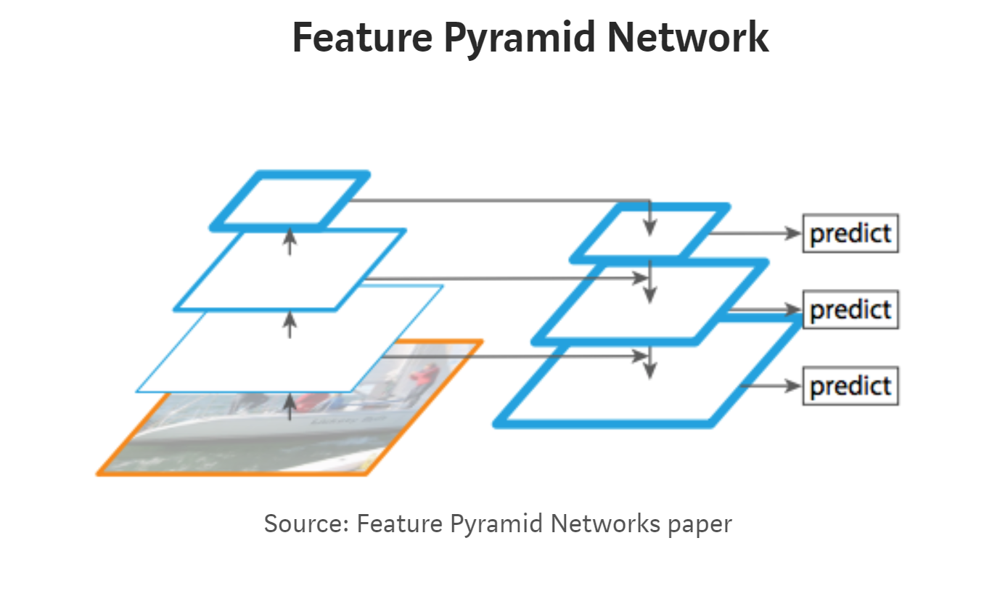
FPN

Slide 6
Object Detection
Faster RCNN : Consist of the layers below
RPN : It detects ROIs which are derived from the anchors
Anchors: The anchors are divided into positive, negative and neutral
Positive anchors: Narrows down to detect the object

Slide 7
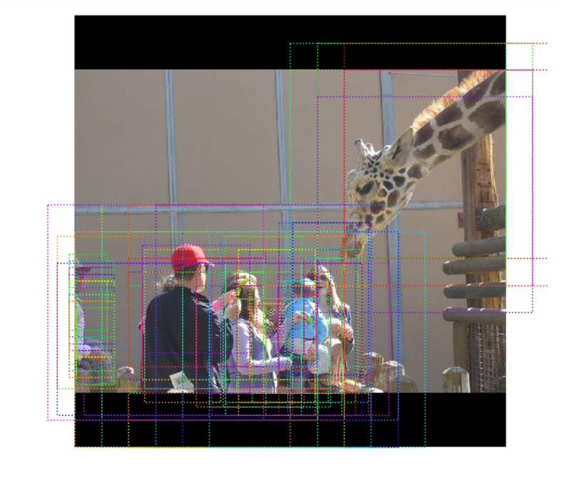
Anchors

Slide 8
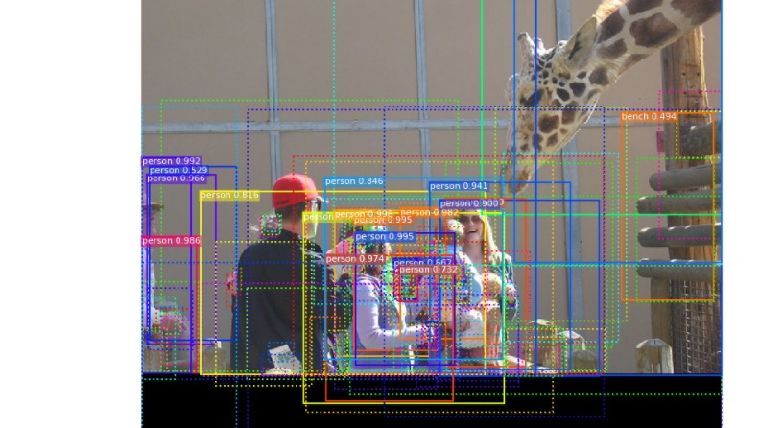

Slide 9
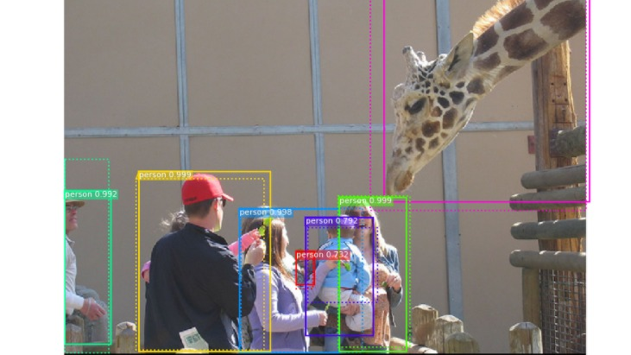

Slide 10
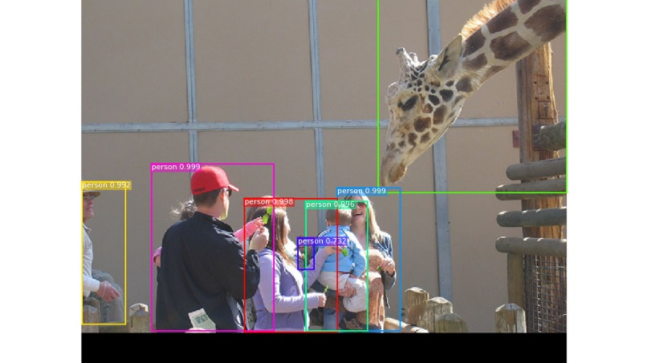

Slide 11
Proposal Classfication
ROI Align: Used instead of ROI pooling since it preserves pixel to pixel alignment over every ROI without information loss.
Labels: Detecting the objects to label them
Scores: Confidence Score for each of the object detected

Slide 12
Semantic Segmentation
FCN : It generates mask over each ROI
Solves information loss by using convolution layers
Convolution and ReLU layers are used for down sampling
It offers pixelwise class prediction
Up sampled for pixel wise prediction

Slide 13
Realtime Integration
Testing the model on our own trained weights
Implementation with webcam using Opencv
Integrating the masks and bounding box to display frame translation
Tracking of the object constantly once identified in the frame

Slide 14
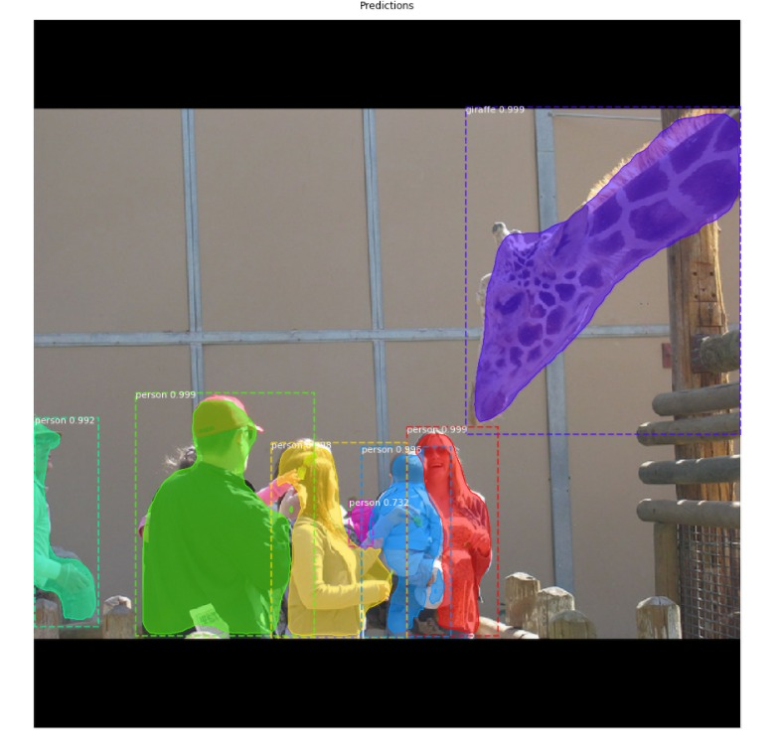
Output of the model on Images
This is based on our own trained model ran on aws
We were able to generate an almost similar accuracy
as the paper

Slide 15
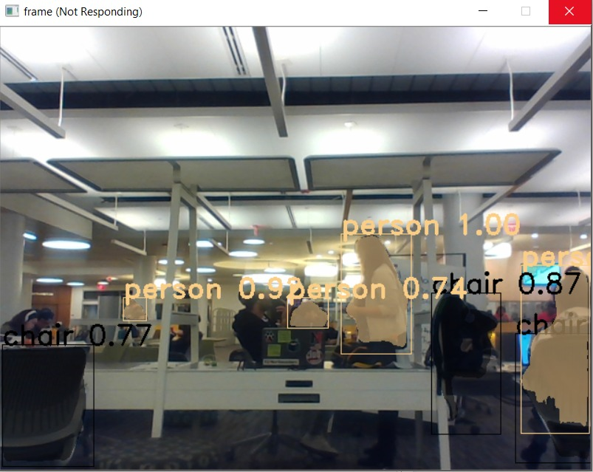
Real Time Output
This is based on the trained model
ran on a personal cpu machine

